Slide 1
Chapter 9: Network Theorems EEE Lecture-12

Slide 2
Network Theorems
Electric circuit theorems are always beneficial to help find voltage and currents in multi-loop circuits.
Mainly help in simplification of a complex circuit and easily let us calculate the current/voltage through a component of interest.
This theorems are applied throughout the field of electricity and electronics.
They provide an opportunity to determine the impact of a particular source or element on the response of the entire system.
In most cases, the network to be analyzed and the mathematics required to find the solution are simplified.
All of the theorems appear again in the analysis of ac networks.

Slide 3
Network Theorems
Superposition Theorem
Thevenin’s Theorem
Norton’s Theorem
Maximum Power Transfer Theorem
Substitution Theorem
Millman’s Theorem
Reciprocity Theorem

Slide 4
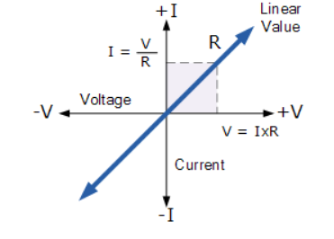
Linear Bilateral Network
Linear network means a network in which the relation between voltage and current is illustrated using a straight line.
A circuit or network whose parameters i.e. elements like resistances, inductances and capacitances are always constant irrespective of the change and direction of current, time and voltage etc. is known as Bilateral network.
Ohm’s law can be applied to such network. a bilateral circuit permits the current to flow in both directions.

Slide 5
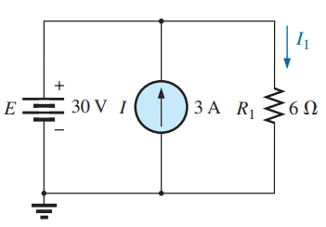
9.2 Superposition Theorems
The superposition theorem states the following:
The current through, or voltage across, an element in a linear bilateral network is equal to the algebraic sum of the currents or voltages produced independently by each source.
In other words, this theorem allows us to find a solution for a current or voltage using only one source at a time. Once we have the solution for each source, we can combine the results to obtain the total solution.
The term algebraic appears in the above theorem statement because the currents resulting from the sources of the network can have different directions, just as the resulting voltages can have opposite polarities.

Slide 6
9.2 Superposition Theorems
Superposition theorem has its unique ability to separate the impact of each source (voltage/current) on the quantity of interest.
The most obvious advantage of superposition theorem, is that it does not require the use of a mathematical technique such as determinants to find the required voltages or currents.
Instead, each source is treated independently, and the algebraic sum is found to determine a particular unknown quantity of the network.

Slide 7
9.2 Superposition Theorems
Step 1: Analyze networks that have two or more sources which are not in series or parallel.
Step 2: Reveal the effect of each source on a particular quantity of interest.
Step 3: For sources of different types, apply a separate analysis for each type, with the total result simply the algebraic sum of the results.

Slide 8
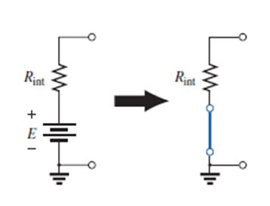
9.2 Superposition Theorems
If we are to consider the effects of each source, the other sources obviously must be removed. Setting a voltage source to zero volts is like placing a short circuit across its terminals.
Therefore, when removing a voltage source from a network schematic, replace it with a direct connection (short circuit) of zero ohms. Any internal resistance associated with the source must remain in the network.

Slide 9
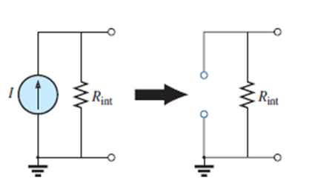
9.2 Superposition Theorems
Therefore, when removing a current source from a network schematic, replace it by an open circuit of infinite ohms. Any internal resistance associated with the source must remain in the network.
Setting a current source to zero amperes is like replacing it with an open circuit.

Slide 10
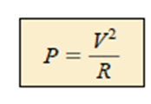

9.2 Superposition Theorems
Since the effect of each source will be determined independently, the number of networks to be analyzed will equal the number of sources.
Superposition cannot be applied to power effects because the power is related to the square of the voltage across a resistor or the current through a resistor.
The squared term results in a nonlinear (a curve, not a straight line) relationship between the power and the determining current or voltage.

Slide 11
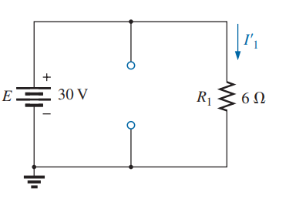
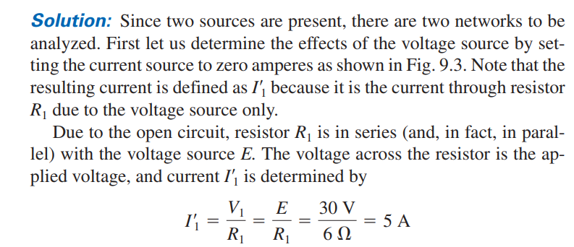

Slide 12
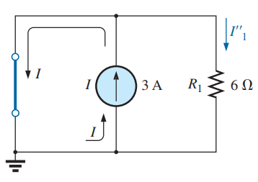
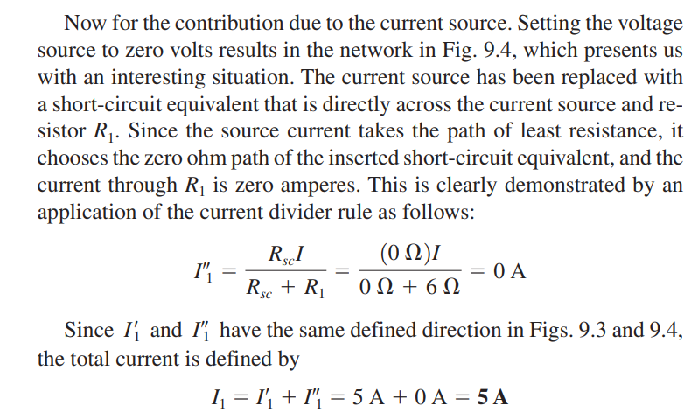

Slide 13
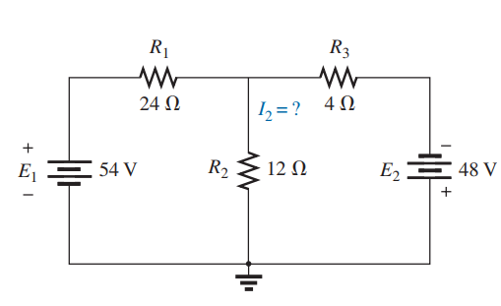

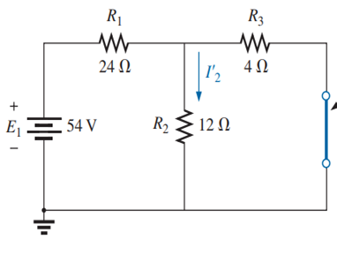
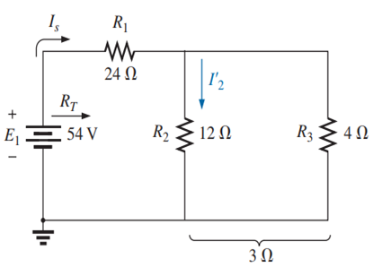

Slide 14
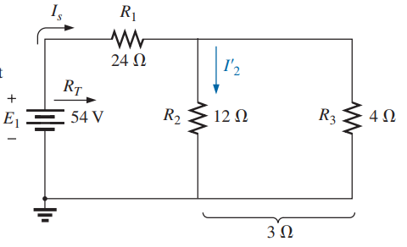
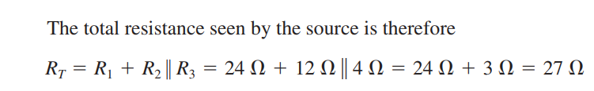
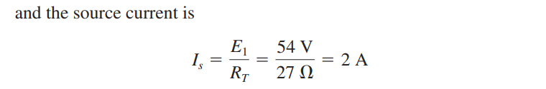
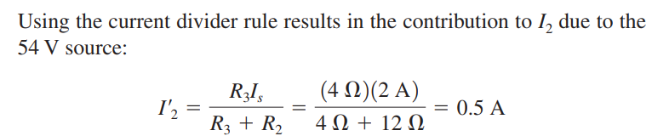

Slide 15
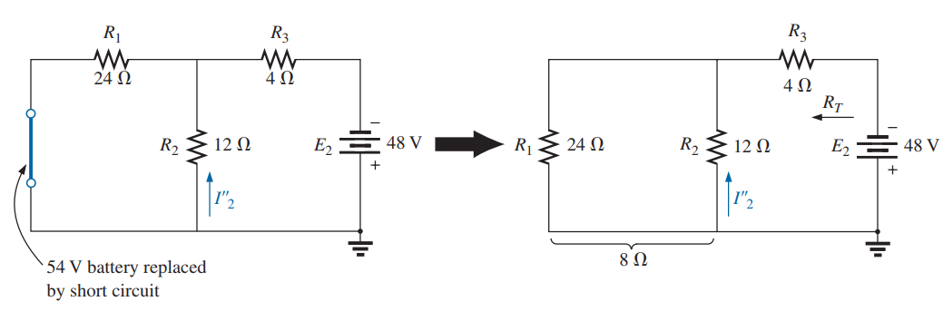
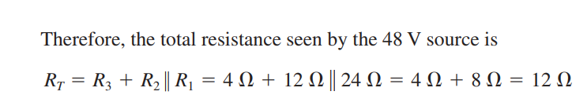
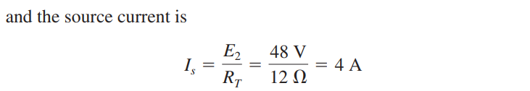
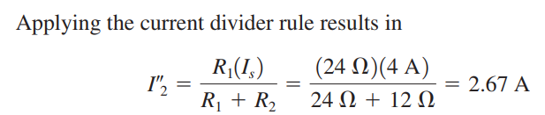

Slide 16
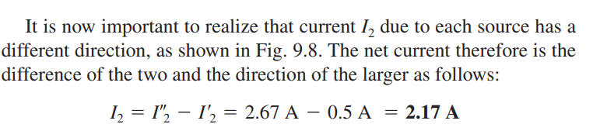
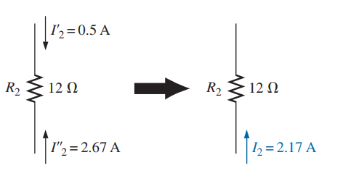

Slide 17
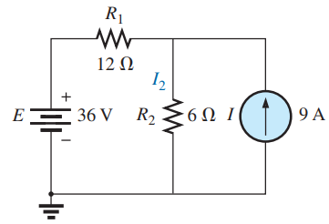
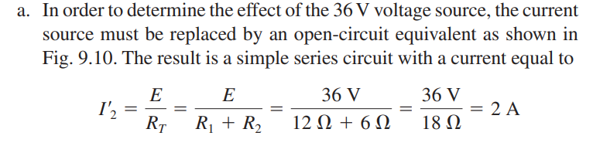
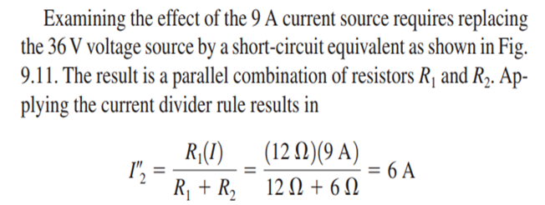
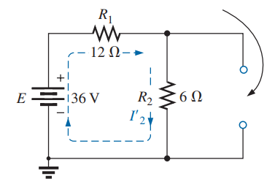
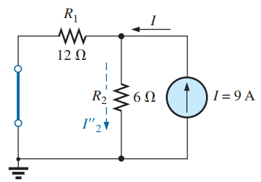
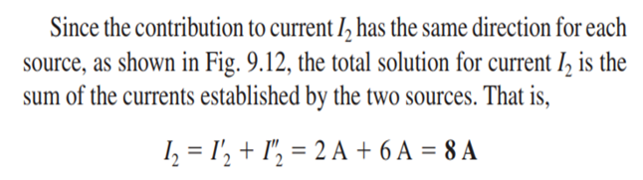
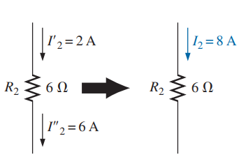

Slide 18
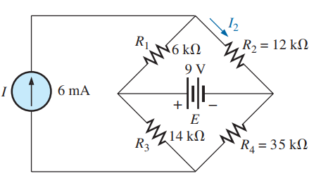

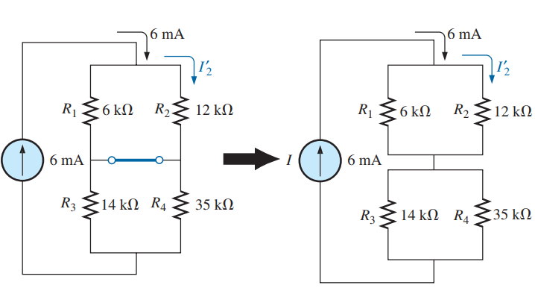
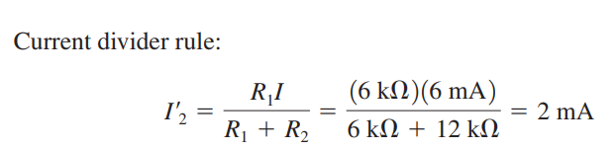

Slide 19
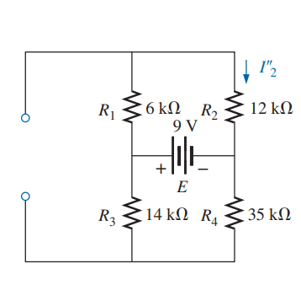
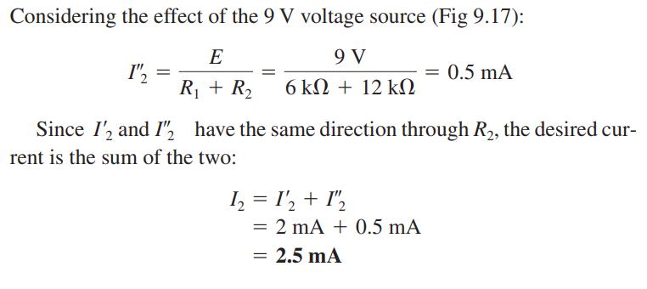

Slide 20
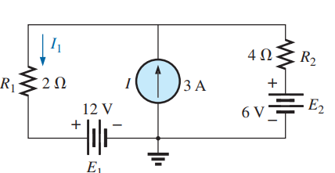
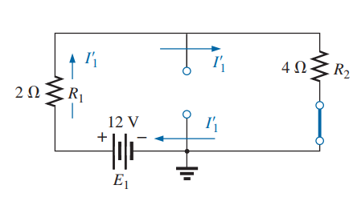
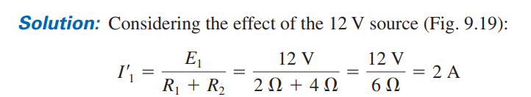
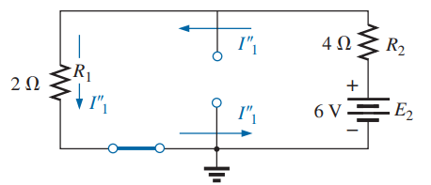
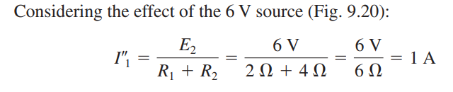

Slide 21
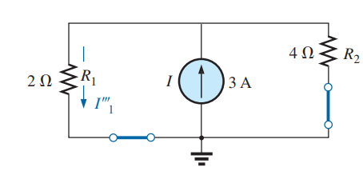
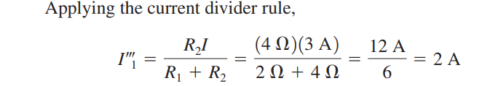
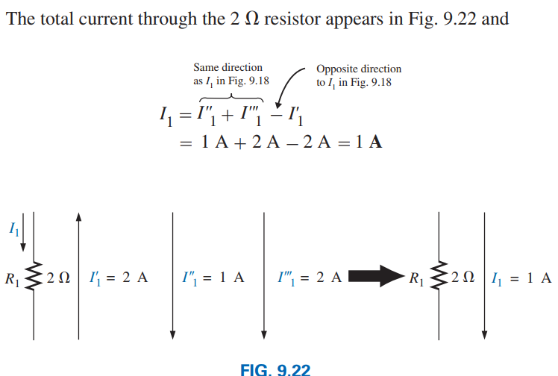

Slide 22
Limitations of Superposition Theorem
Superposition theorem is not applicable for power calculations.
Superposition theorem is strictly applicable for Linear circuits only.
Superposition theorem is not applicable to a network containing time varying resistors.
Another limitation of Superposition Theorem is that this theorem only applied to the circuits with more than one source.

Slide 23
Thank You

